Slide 1
Secrets of an Umbraco Ninja
Simplifying development with Umbraco

Slide 2
Who am I?
Aaron Powell
@slace on twitter
ASP.NET Developer
Work at TheFARM Digital
Official title is .NET Ninja
Umbraco Core Team member for ~18 months
Self proclaimed Umbraco Ninja

Slide 3
What this session is about?
What is Umbraco?
How can Umbraco simplify development?
Integrating Umbraco with rich media technologies
Tips and tricks for better Umbraco development

Slide 4
What is Umbraco?
One of the leading Open Source .NET CMS’s
Just celebrated 5 years as an Open Source project
Over 85,000 installs world wide (Fall 2009)
Top 10 CodePlex projects
Top 2 Web PI downloads
Average of 5,000 downloads per month
Footprint of around 15Mb
Notes:
- Latest install count was almost 85,000 (fall 2009) - WebPI downloads are 113,000 (since MIX09 in March 2009) - Codeplex downloads were roughly 250,000 in 2009 (but that includes close to a 100,000 of the WebPIs)

Slide 5
What do you get?
Bare-bones CMS
OOTB there are no templates, document types or pages
XML-based content cache
Lends itself to XSLT for UI
Open .NET API
Almost all aspects of the CMS can be interacted with

Slide 6
Community Focus
Large community of developers
20+ packages downloadable from the official repositories
Additional packages available off the community site
200+ available
Over 350 Certified Developers world-wide
About 40 Solution Providers world-wide
Notes:
Training sessions happening almost monthly around the world

Slide 7
Umbraco 4.1
Upcoming release of Umbraco
Currently in Beta 2
Has a much improved UI
Smaller UI request
Data layer improvements
Fewer requests than previous version
More primary/ foreign key constraints
API clean-up
Many obsolete methods
Provider-based LINQ API
Built-in Lucene.Net indexer
Notes:
Getting the current node had about half a dozen different ways to be accessed
30% less requests for backend UI, up to 70% less in size
40% less database requests

Slide 8
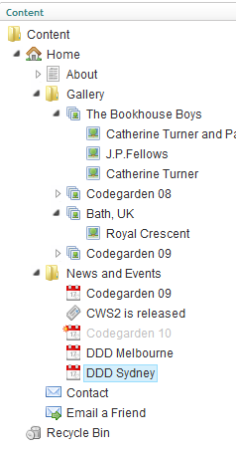
How can Umbraco help you?
No defaults means no starting restriction
Admin required on most sites
Umbraco offers pre-built admin system
Simplistic
Built-in user security levels
Basic workflow OOTB

Slide 9
Programming concepts in a content world
Document Types are highly flexible
Match up very well with the class concept in programming
Properties with types
Inheritance
Relationships

Slide 10
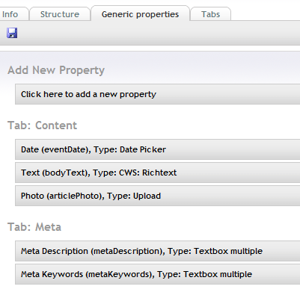
Programming concepts in a content world
Content stored hierarchically
Content can be related to each other
Content Picker
Ultimate Picker
Content is cached
No need to interact with a database

Slide 11
Demo
Structuring within the CMS
Notes:
Designing document types for a stores listing

Slide 12
Getting at your data
Several ways which the data can be served to the client:
XML cache
LINQ to Umbraco
Lucene.Net
Restrictive searches can be used to return data
Another level of cache

Slide 13
Using XSLT
Alt-Templates
Query string on URL
Great for per-page
Not great when using single app
Custom XSLT API
Leverage .NET XSLT engine
Less coupled to Umbraco

Slide 14
LINQ to Umbraco
New in 4.1
Similar concepts to LINQ to SQL
Treats data in non-hierarchical fashion
Works with XML cache
Provider based so it can work with any data source

Slide 15
Lucene.Net
Examine is a new API for 4.x
OOTB in 4.1
Stores data for searching
Restricted searches can act like XPath
Can be very fast

Slide 16
Demo
Working with the API
Notes:
Show off nodeFactory, LINQ to Umbraco and Examine

Slide 17
Ninja Tricks

Slide 18
Alphabetizing Content Trees
Scenario
List of resellers which are CMS managed
Searching in the front-end to find them so CMS order is irrelevant
How can we make it easy to look at the stores?
Umbraco ordering is self-managed
We could change the node SortOrder property
But this results in database operations
Notes:
DB-level sorting is very intensive. Have to get back all nodes, then bubble sort them, and then write it all back to the DB. Bad if you have dozens of nodes!

Slide 19
Alphabetizing Content Trees
4.1 has several new Tree events
BaseTree.AfterTreeRender is what we need
It’s passed the complete tree which we can manipulate

Slide 20
Demo
Ordering content alphabetically

Slide 21
Adding Preview to 4.1
Already kind of works
Using <umbraco:Item /> works fine
Full support can be achieved with Examine
Examine supports unpublished content
One index for published one for unpublished
Conditional statements to select appropriate searcher

Slide 22
Adding Preview to 4.1
Pros
Supports 4.0 & 4.1
Often faster than memory cache
Cons
Very custom development
Can be difficult to support XSLT
Can’t use XSLT macros
Note – 4.1 has a fixed preview engine

Slide 23
Demo
Faking Preview

Slide 24
Unit-Testable Macros
Any .NET UserControl macros can be made unit testable
Use WebForms MVP to add testability
Macros operate just the same
Not possible with XSLT macros

Slide 25
Demo
Unit-Testable Macros

Slide 26
Questions, comments, abuse?
References
http://aaron-powell.com
http://farmcode.org
http://umbraco.codeplex.com
http://our.umbraco.com
http://webformsmvp.com
Upcoming Training:
Melbourne: 9th – 12th August
Sydney: 3rd – 6th August
http://littlewebempire.com

